Slide 1




















ISLAMIC BANKING AND FINANCE IN AFRICA
EMERGING OPPORTUNITIES AND ROLE OF CENTRAL BANKS
PRESENTATION AT THE 10TH AFRICAN ISLAMIC BANKING AND FINANCE SUMMIT IN BANJUL, GAMBIA

Slide 2




OUTLINE
Introduction
Opportunities
Challenges
Role of Central Banks
Conclusion

Slide 3

INTRODUCTION
Islamic Banking and Finance has little traction in Africa and yet it has potential for growth in Africa given the continent’s demographic structure and prospects for financial deepening.
Projected to reach
US$ 5.90 trillion
by 2026
Islamic banking and finance assets have concentrated historically in the Middle East and Malaysia. These markets currently account for more than _{80%} of industry assets
Indeed, in Africa has a chance to be a true innovator for the Islamic finance industry
As at end 2021, Total Assets Vale of Islamic Finance was US$ 3,95 trillion
Sub Saharan Africa (SSA) has around 18% of the world’s
Muslim Population and yet its Islamic finance assets make up only _{1%} of such global assets

Slide 4


OPPORTUNITIES FOR ISLAMIC BANKING AND FINANCE IN AFRICA
Africa has a chance to be a true innovator for the Islamic finance industry
Africa is a region where Islamic Finance could thrive....

Slide 5


DRIVERS OF POTENTIAL GROWTH IN ISLAMIC FINANCE AND BANKING IN AFRICA?
i. Infrastructure development deficit creates financing gap, which could be filled by Islamic finance.
ii. The Muslim population in SSA is projected to grow by nearly 60 % from
the 2010 position of to US$385.9 M
US$242.5 M
in 2030

Slide 6

iii. Potential instruments for financial inclusion. European Investment Bank estimates that as at at 2017, 350 MILLION Africans did not have bank accounts
DRIVERS OF POTENTIAL GROWTH IN ISLAMIC FINANCE AND BANKING IN AFRICA?
iv. Africa Development Bank (AfDB) estimates Africa’s infrastructure deficit at US$100 BILLION a year
and this is estimated to increase to as much as
US$170 BILLION
per year by 2025

Slide 7
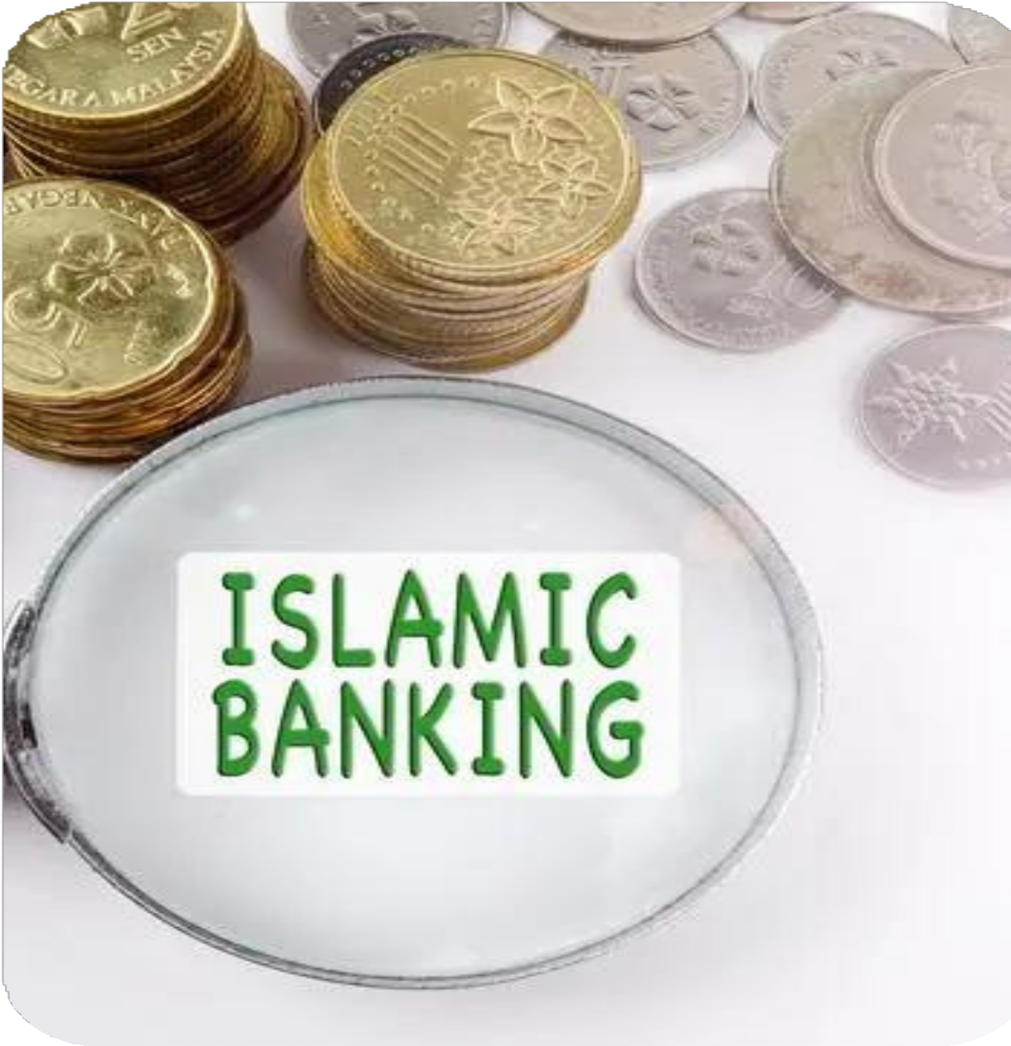
STRIDES BY AFRICAN COUNTRIES
Some African countries have already started taking steps to support the local uptake of this financing mechanism
Countries have introduced legal and regulatory frameworks to promote the development of Islamic finance products in their respective jurisdictions.
Nigeria, Tunisia and South Africa are now home to Islamic banks and takaful (Islamic insurance) companies.
A number of traditional banks across the continent have also started to offer Shari'ah-compliant banking products through "Islamic windows”
South Africa, Nigeria, Kenya, Senegal, Djibouti, Uganda and Morocco are examples of such countries
At the level of governments, some have either started issuing international or domestic sukuk or "Islamic bonds South Africa, Senegal and Nigeria are examples of such countries

Slide 8
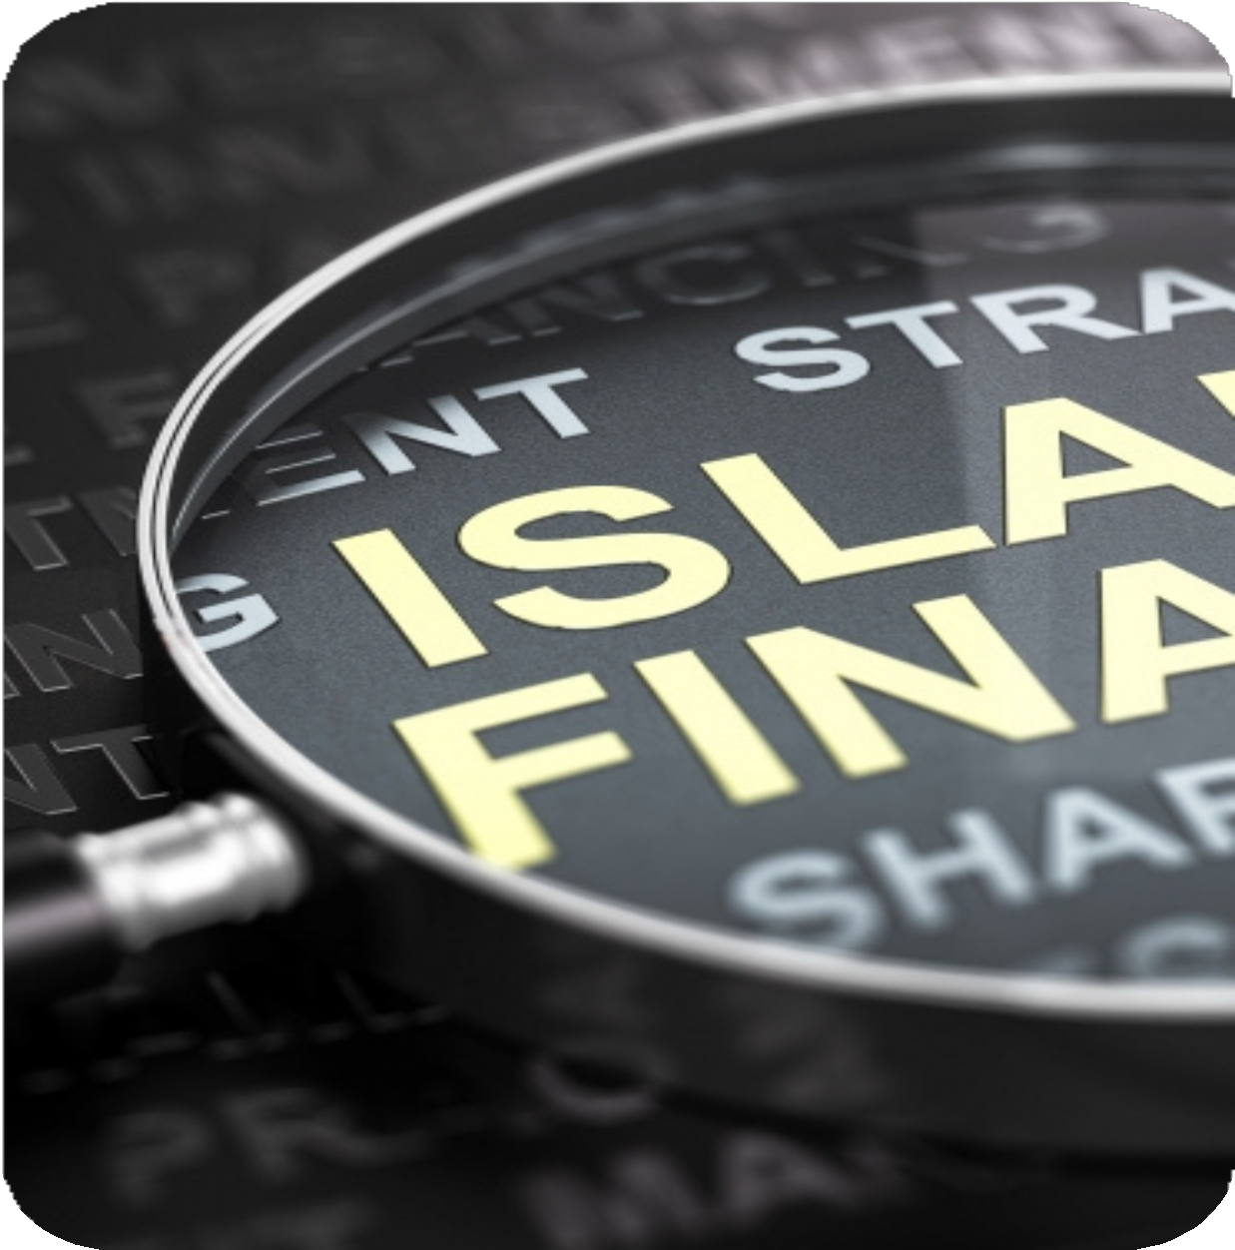
CHALLENGES FACED BY ISLAMIC BANKING AND FINANCE IN AFRICA
Regulatory Gap -The existing regulatory framework of most African countries was not designed to cater to interest-free financings based on the sharing of economic risks and rewards and Shari'ah-compliant assets and liabilities.
These principles are however fundamental to Islamic finance.
Knowledge Gap: Islamic Finance and Banking is poorly understood in most African countries among the citizenry and regulators alike

Slide 9
CHALLENGES FACED BY ISLAMIC BANKING AND FINANCE IN AFRICA
It has been difficult to convince people that, this is an alternative means of financing as opposed to a religious activity
Clarity is crucial regarding the legal enforceability of Islamic finance products
The relatively low penetration of formal banking services across Africa represents a barrier to entry for conventional and Islamic financial institutions offering Shari'ah-compliant banking products—such as Shari'ah- compliant personal loans, mortgages and takaful.
Regulatory and knowledge gaps in Africa will take time to address, but positive trends are already evident.

Slide 10
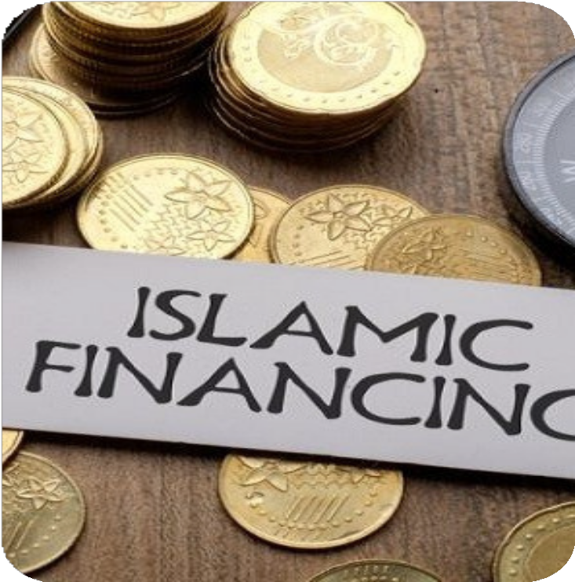
THE UPSIDE...
Fortunately, Islamic multi-lateral development institutions are helping in standard-setting and capacity building.
Islamic Financial Services Board (IFSB), a multilateral body based in Kuala Lumpur. Among other things, the IFSB does the following:
Implementation of global prudential and supervisory standards and other initiatives that foster knowledge sharing and cooperation among its members.
Through IFSB, Bank Negara Malaysia has since 2008 run more than 300 Islamic finance programs and study visits for more than 25 African countries, including Nigeria, Sudan, Tanzania and Kenya.
Some African financial institutions and government-related entities (such as the Kenyan Capital Markets Authority) have become members of the Islamic Financial Services Board

Slide 11
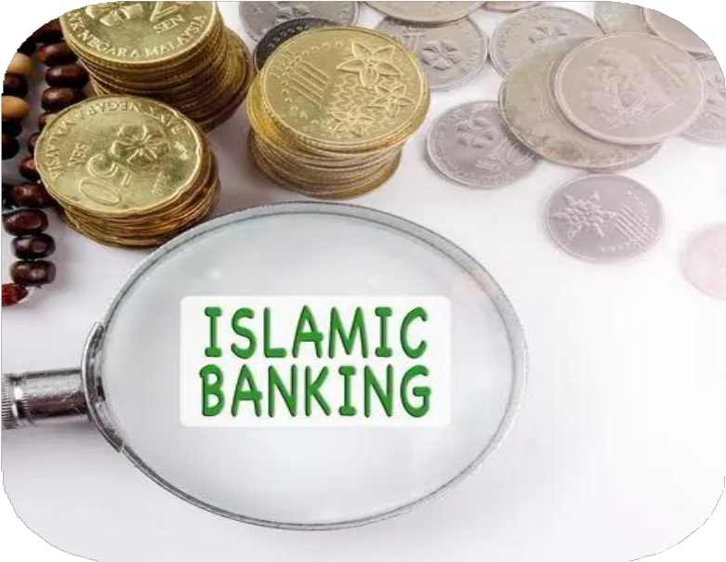
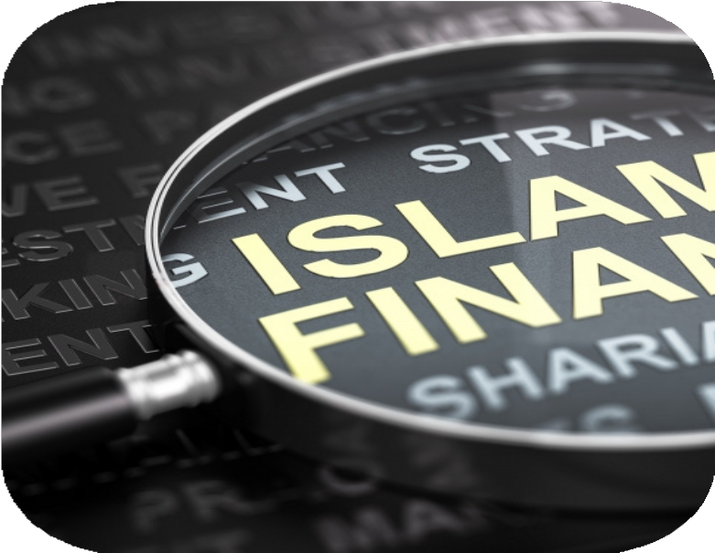
The Islamic Corporation for the Development of the Private Sector (ICD)—the private sector arm of the Islamic Development Bank (IDB) and the largest Shari'ah-compliant multilateral development bank in the world—also continues to play a role in developing Islamic finance in Africa by arranging local sovereign sukuk issuances
There is Accounting and Auditing Organisation for Islamic Financial Institutions (AAOIFI) which prepares accounting, auditing, governance, ethics and Sha’riah standards for Islamic Financial Institutions and many African countries are leveraging on their services

Slide 12
ROLE OF CENTRAL BANKS IN HARNESSING ISLAMIC BANKING AND FINANCE POTENTIALS IN AFRICA
Facilitating capacity building
Working closely with IFSB to develop prudential standards necessary for the financial soundness of Islamic financial institutions
Islamic finance is a complex industry undergoing rapid product innovation
The number of people familiar with Islamic finance mechanisms is very small, highlighting the importance of building technical knowledge and skills
To facilitate monetary policy transmission in Islamic Banking environment African Centrak Banks could help to develop a Shari’ah- compliant (i) interbank market, (ii) a liquidity management facility/center, and (iii) a repo market.
Collaboration and exchanges with leading countries such as Malaysia could be beneficial to help countries trying to develop Islamic finance build capacity with best practices and standards.
Collaboration and exchanges with leading countries such as Malaysia could be beneficial to help countries trying to develop Islamic finance build capacity with best practices and standards
This will also help in liquidity management among Islamic Banks as most Islamic banks hold excess liquidity

Slide 13

THE ROLE OF CENTRAL BANKS...
Financial safety nets. The financial safety net, namely, lender of last resort (LOLR) facilities and emergency financing mechanisms as well as deposit insurance are key components of a sound financial system.
Central banks could help to strengthen the financial safety net to comply with Shari’ah principles.
Crisis management and resolution framework. Another important area for central banks is the development of a Shari’ah- compliant crisis management and resolution framework, which includes:
bank insolvency laws and the arrangements for dealing with nonperforming assets,
asset recovery and bank restructuring, iii.bankruptcy,
iv.bank recapitalization

Slide 14
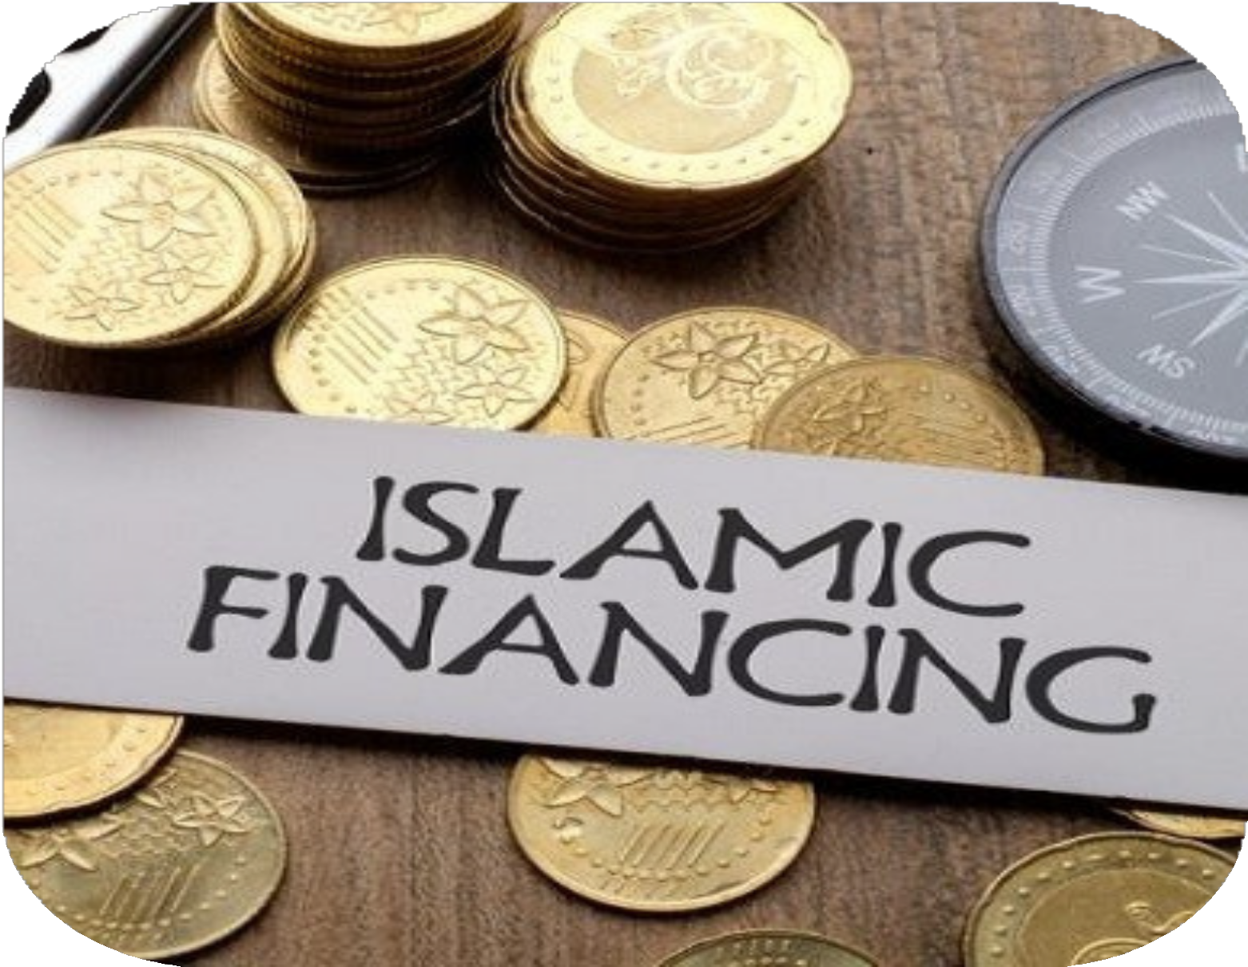
CONCLUSION
Islamic finance in Sub-Saharan Africa is at a nascent stage,
However, it has potential due to the size and expansion of its Muslim population
Islamic finance broadens the range of financial services and thus has the potential to promote financial inclusion in Africa
Islamic financing can also contribute to the development of small and medium enterprises and microfinance activities

Slide 15
THANK YOU

